Slide 1

Quest for Riches: Unleashing Adventure in the Treasure Hunt Game!
TEAM NAME - PRANNAT
Pranjali gupta Mannat mehta

Slide 2





Introduction to Treasure Hunts
Welcome to the
will explore the exciting world of
! In this presentation, we
. Discover
how they spark creativity, teamwork, and adventure. Get ready to unleash your inner explorer and embark on a journey filled with and !

Slide 3
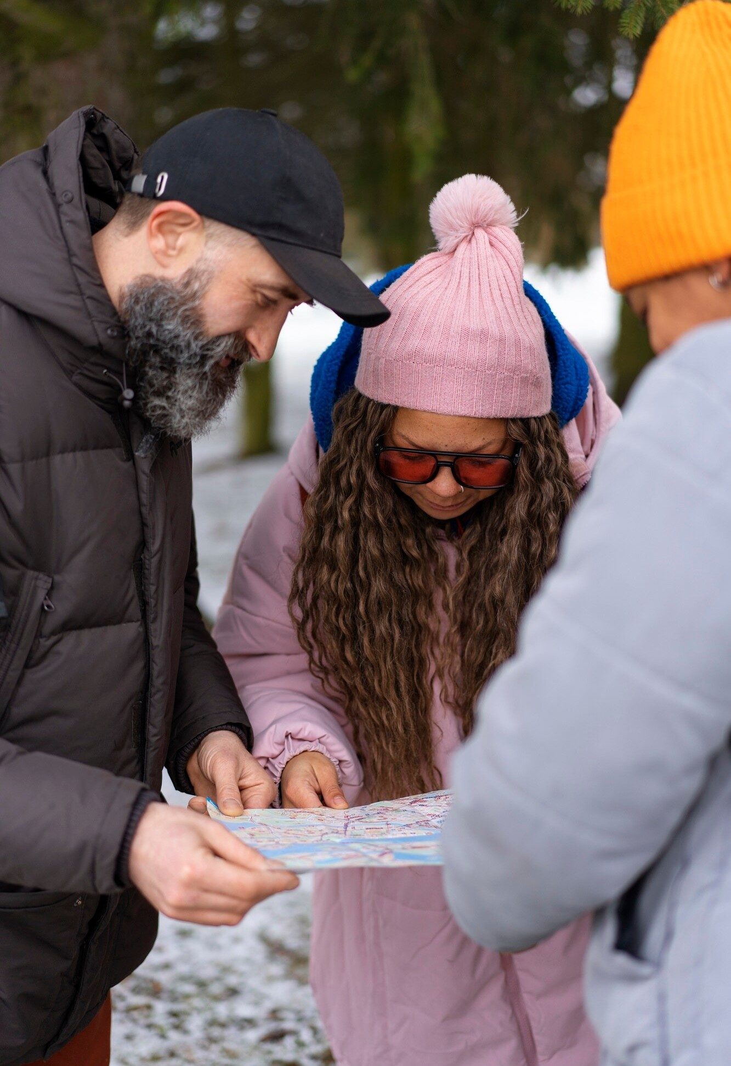




The Allure of Adventure
What makes treasure hunts so appealing? The thrill of the
, the excitement of , and the joy of
. Each hunt oﬀers a unique story waiting to be uncovered. Participants engage their and
skills, making every experience unforgettable.

Slide 4






Creating the Perfect Hunt
Designing a treasure hunt requires creativity and . Start with a compelling and develop that challenge participants. Ensure the hunt is balanced, combining
and to keep everyone engaged.
Remember, the journey is just as important as the !

Slide 5




Teamwork in Action
Treasure hunts are a fantastic way to promote . Participants must communicate, share ideas, and support each other to solve clues. This collaborative eﬀort fosters
and builds a sense of . Together, they can overcome obstacles and celebrate their victories!

Slide 6




The Thrill of Discovery
The moment a clue is solved or a treasure is found is exhilarating! This sense of boosts morale and encourages participants to continue exploring. Each discovery adds to the , making the adventure even more immersive and rewarding for everyone involved.

Slide 7



As we conclude our journey through the , remember that adventure is just a treasure map away! Whether for fun, education, or team-building, treasure hunts oﬀer endless possibilities. So gather your friends, unleash your creativity, and let the adventure begin!

Slide 8



